Slide 1

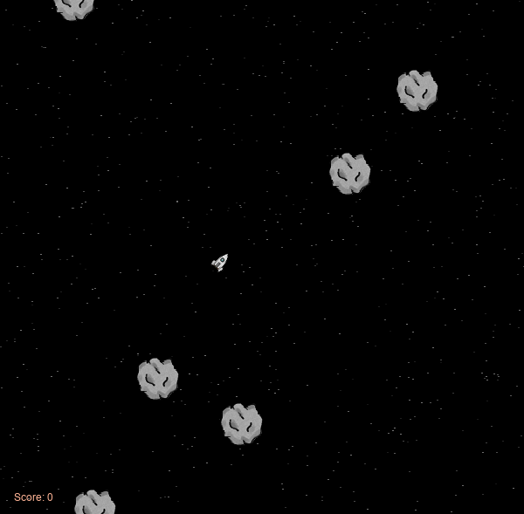
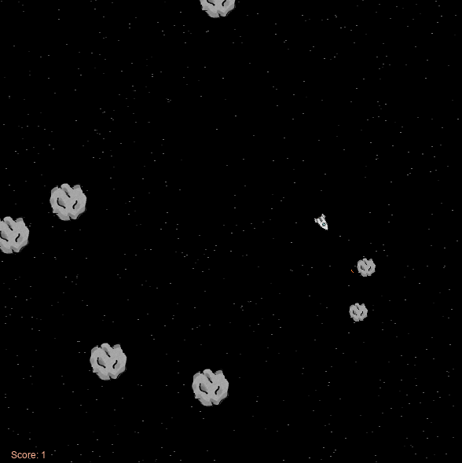
‘The Search For Home’ is about a spaceship crew that got lost in space and now they are trying to return to Earth, however, their journey back is not a pleasant one hence they have to protect the ship from colliding with the asteroids found in space as well as alien ships that present a threat.
How to play (Level 1):
When you spawn in Level 1 there will be asteroids around.
You will have to press ‘Space’ to shoot bullets and destroy them.
Big asteroids will break down into smaller asteroids, and will also give you 1 point which is seen in the score.
The asteroids will get smaller and smaller until they get completely destroyed.

Slide 2
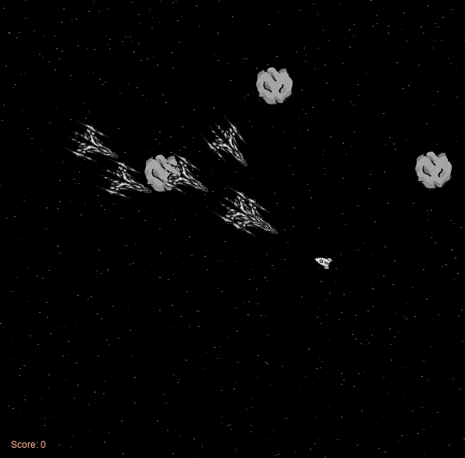
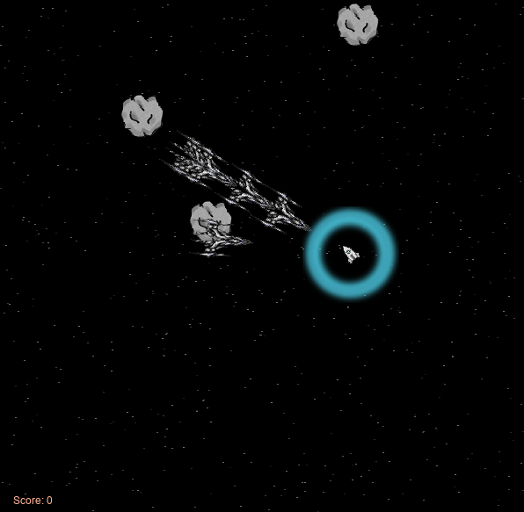
How to play (Level 2):
Everything that was demonstrated in Level 1 applies for Level 2.
In Level 2 there will be an additional gun that destroys everything that it touches but has a longer reload time.
There are asteroids too in this Level.
Here is also where the alien enemy ships come in.
They have more health so they require more bullet hits to destroy.
This is the additional gun, the ProtonWave.
It creates an area around the StarFighter that will destroy anything in its path.

Slide 3
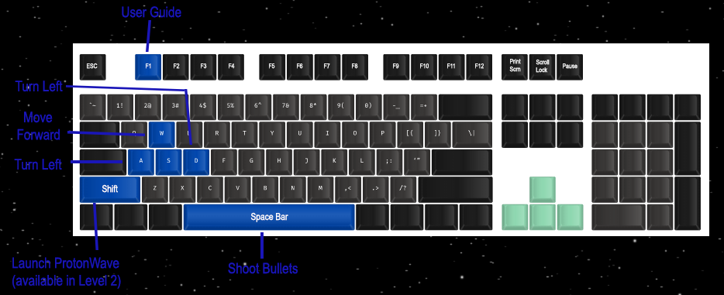
Instructions:
For every Asteroid and/or Alien enemy ship destroyed 1 point is added to the Score
If StarFighter collides with obstacles it will explode and game will be over
You win by destroying all the obstacles that you will face in Level 1 & Level 2
If you pass Level 1 but don’t pass Level 2 you will have to start again from Level 1
Commands:

